Slide 1
Auto leave letter generator
Project by : Girish V. Parate

Slide 2
Technologies used
Python 3.7
tkcalendar
Regular expression
OS commands
tkinter

Slide 3
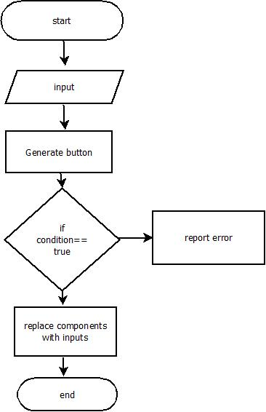
Flow of project :
A project create leave letters as per given inputs from applicants.
On clicking Generate button on screen, the inputs are verifies and matched with pre-defined regular expressions.
If the given input is correct, it replaced with components of draft letters.
The letters are saved in notepad, ex:Annualleave.txt

Slide 4

Index page of project :

Slide 5
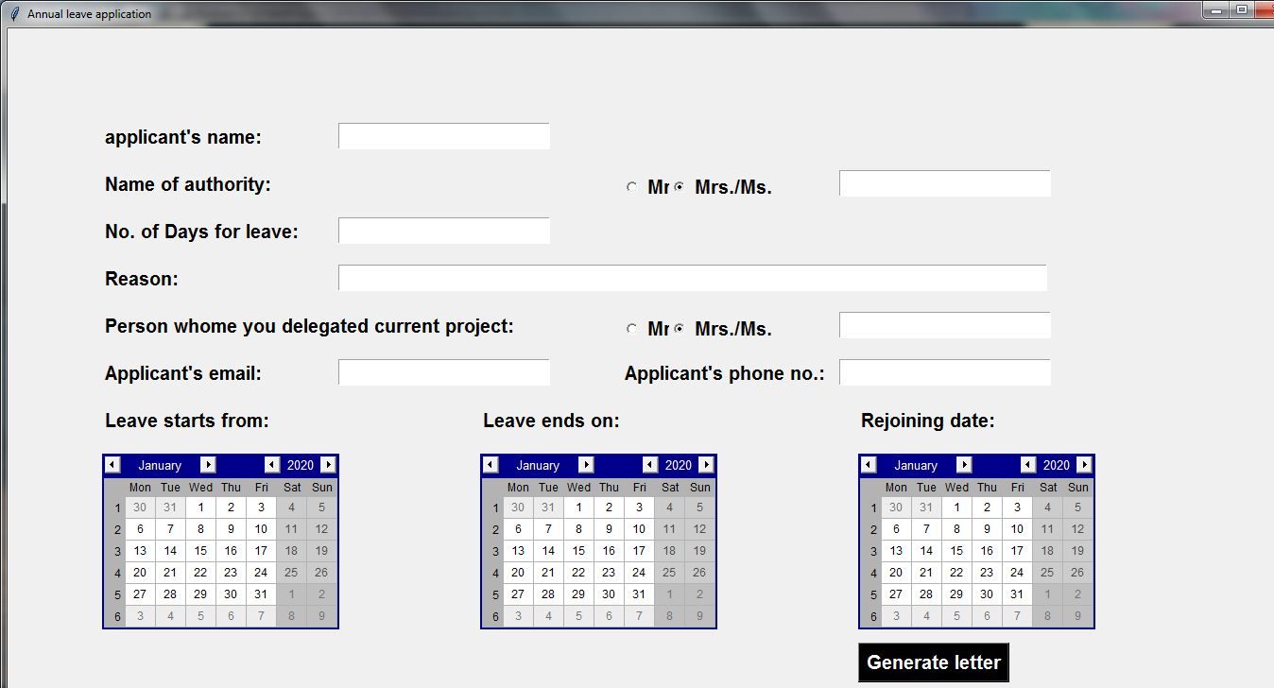
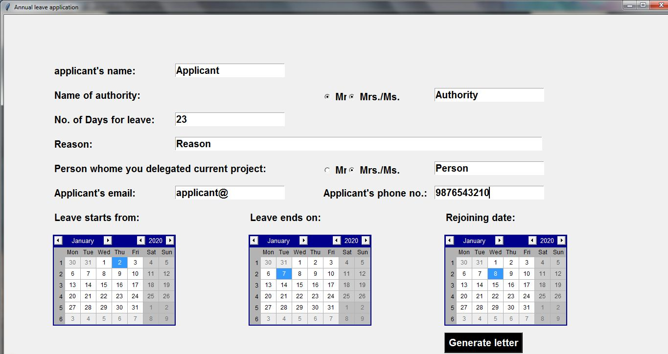
Annual Leave Letter (Example) :
Empty cell :
Filled cell :

Slide 6
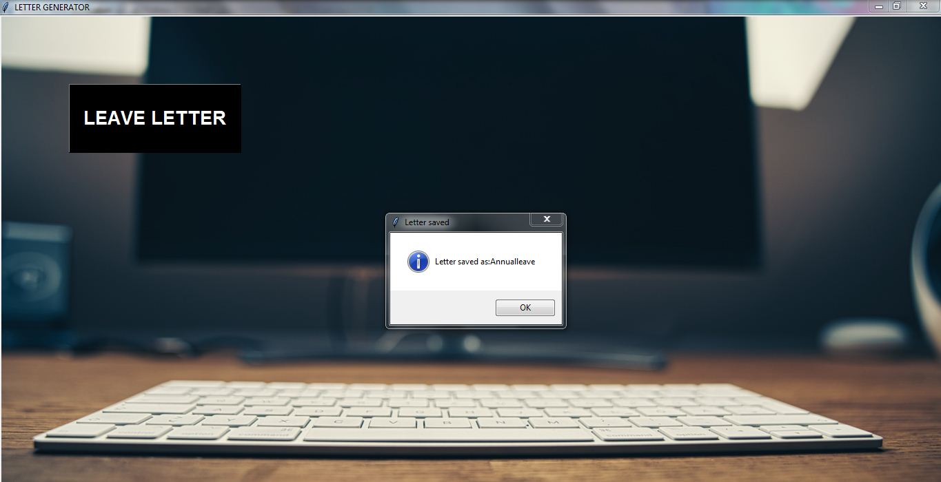
After clicking generate button :

Slide 7
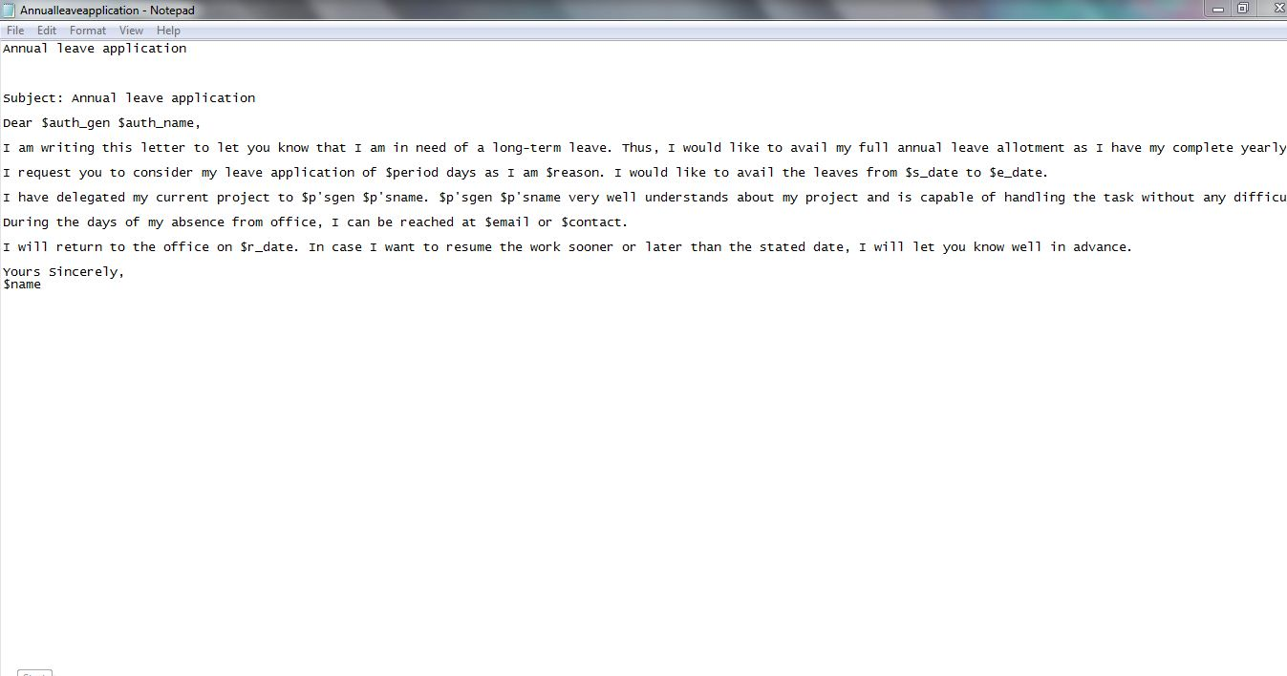
Draft of Annual leave letter :
In the draft letter, you can actually see that, there are some of letters which starts from character “$”.
These letters are then replaced with given input .
The example conditions are as follow:
If contact no. is a number or not equal to 10 digits, then it will through error.
If email doesn’t contain “@”, then it will through error.

Slide 8
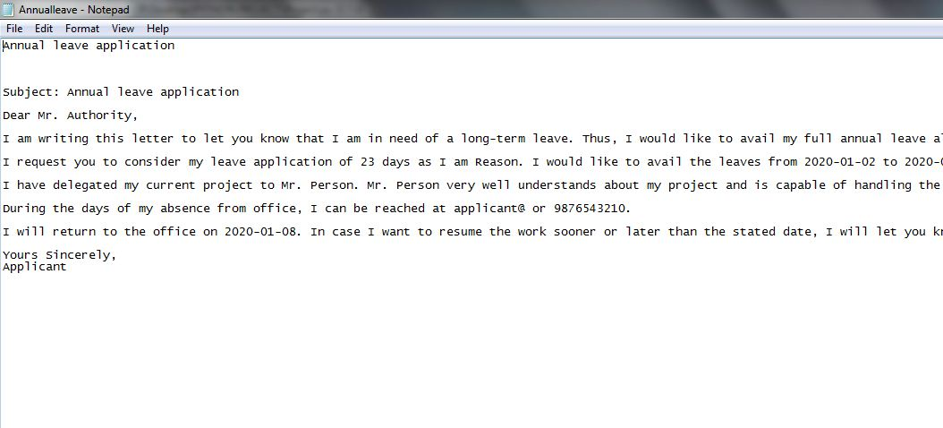
Generated letter :

Slide 9
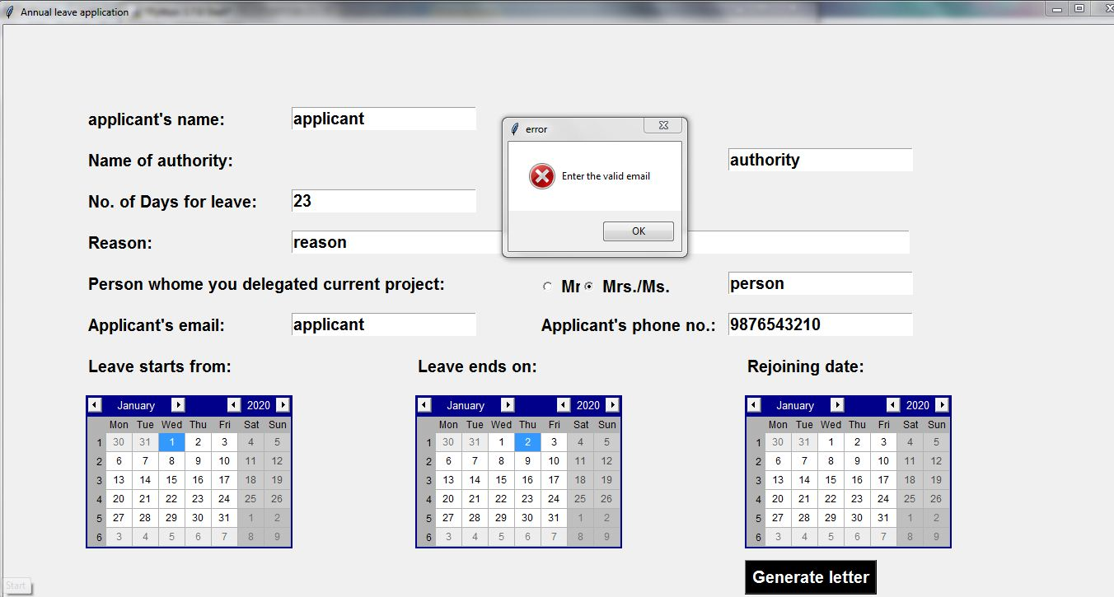
Example :
This is an example when you entered wrong email.
It will show an error in message box.

Slide 10
THANK YOU

